Slide 1

ABE 715
Computer Programming
Lecture 10: Numerical Integration
Calculating Areas and Volumes from Discrete Data
Dr. Kadeghe G. Fue
Department of Agricultural Engineering
1

Slide 2
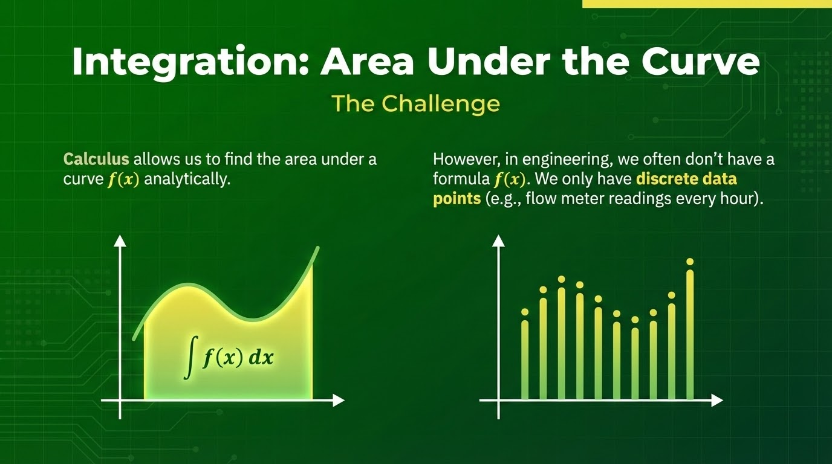

Slide 3
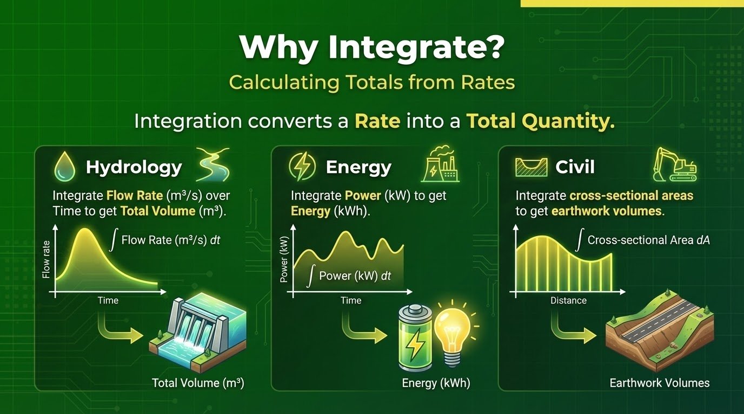

Slide 4
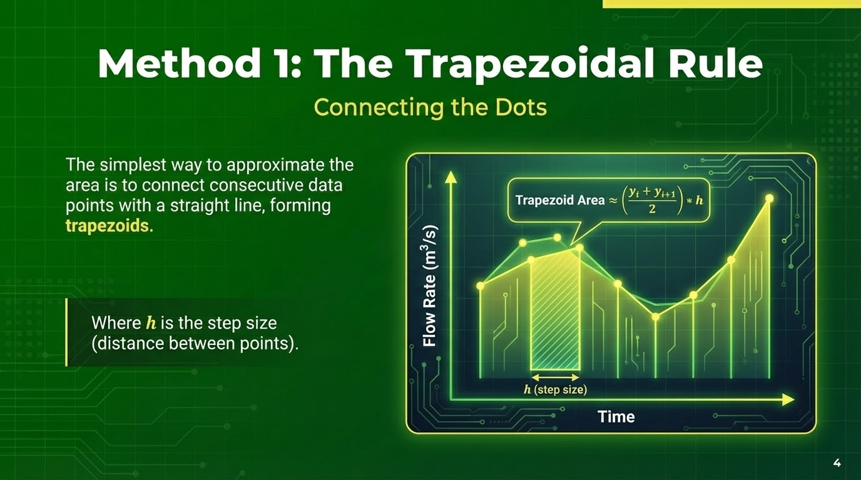

Slide 5
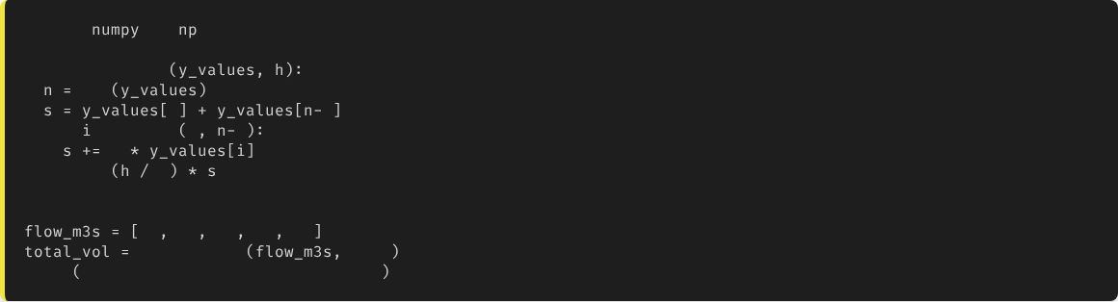
Trapezoidal Rule in Python
import
as
def
trapezoidal
len
0
1
for
in
range
1
1
2
return
2
# Example: Flow rates every 1 hour (3600s)
10
12
15
14
11
trapezoidal
3600
print
f"Total Volume: {total_vol} m3"
5

Slide 6
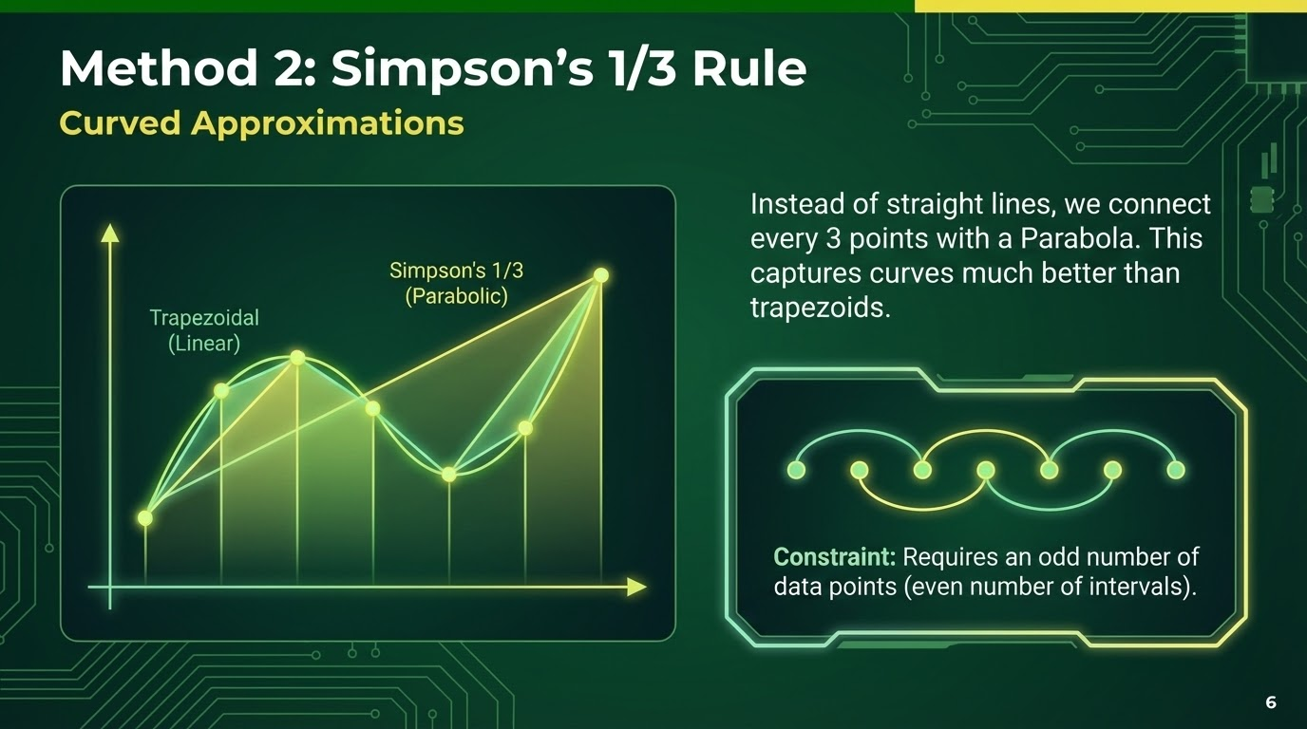

Slide 7
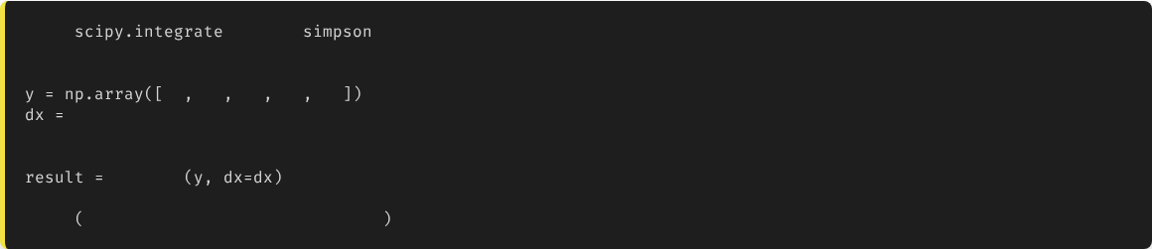
Simpson's Rule in Python
from
import
# Data must be numpy arrays
10
12
15
14
11
3600
# Step size
# SciPy handles the 1/3 logic automatically
simpson
print
f"Precise Volume: {result} m3"
7

Slide 8
Trapezoidal vs. Simpson's
Method | Geometry | Accuracy | Constraints
Trapezoidal | Straight Lines | Moderate | None (any N points)
Simpson's | Parabolas | High | Must have Odd N points
For smooth engineering curves (like water flow or stress-strain), Simpson's rule is usually preferred.
8

Slide 9
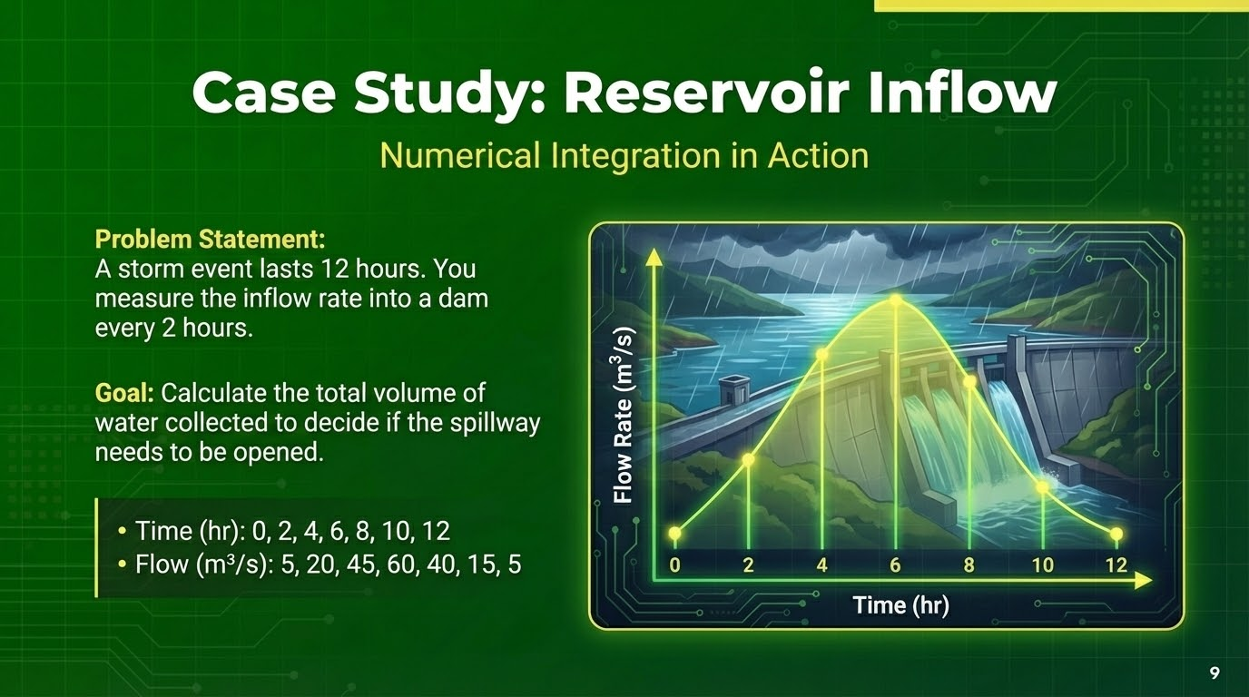

Slide 10



Professional Tools: SciPy Integrate
scipy.integrate.quad
scipy.integrate.trapezoid
scipy.integrate.simpson
Used when you have a Function (f(x)). Highly accurate adaptive integration.
Used when you have Data Points (Arrays). Robust and simple.
Used when you have Data Points. Higher accuracy for smooth data.
10

Slide 11
Best Practices
Check Units: If Flow is in \(m^3/s\) and Time is in Hours, you must multiply the result by 3600 to get Volume in \(m^3\).
Data Regularity: Integration methods work best when time steps (\(h\)) are constant. If data is irregular, use Trapezoidal.
Missing Data: Fill missing values (Interpolation) before integrating.
11

Slide 12

Lecture 10: Take-Home Assignment
Runoff Volume Calculation
Data: You have rainfall intensity measurements (mm/hr) taken every 30 minutes during a 4-hour storm.
rain = [0, 5, 15, 30, 25, 10, 5, 2, 0] (9 data points)
Task:
1.
Create a Python script using Simpson's Rule.
2.
Calculate the Total Rainfall Depth (mm). (Hint: Step size is 0.5 hours).
3.
If the catchment area is 10 Hectares, calculate the total runoff volume in Liters.
4.
Print the final volume.
12

Slide 13
Questions?
Next Class: Final Project Workshop
Dr. Kadeghe G. Fue
Department of Agricultural Engineering
13

